Slide 1
Charm++ Applications as case studies
Only brief overview today

Slide 2
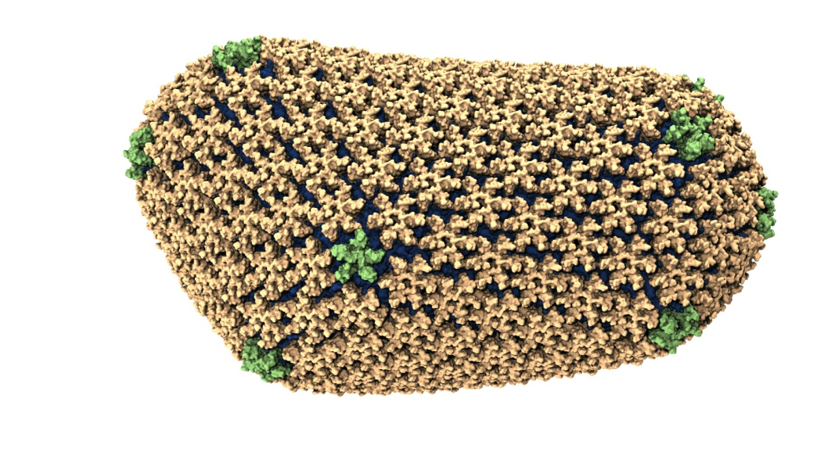
NAMD: Biomolecular Simulations
Collaboration with K. Schulten
With over 50,000 registered users
Scaled to most top US supercomputers
In production use on supercomputers and clusters and desktops
Gordon Bell award in 2002
Recent success: Determination of the structure of HIV capsid by researchers including Prof Schulten

Slide 3
NAMD: Molecular Dynamics
Collection of [charged] atoms, with bonds
Newtonian mechanics
At each time-step
Calculate forces on each atom
Bonds:
Non-bonded: electrostatic and van der Waal’s
Calculate velocities and advance positions
1 femtosecond time-step, millions needed!
Thousands of atoms (1,000 - 100,000)
Collaboration with K. Schulten, R. Skeel, and coworkers

Slide 4
Further MD
Use of cut-off radius to reduce work
8 - 14 Å
Faraway charges ignored!
80-95 % work is non-bonded force computations
Some simulations need faraway contributions

Slide 5
Traditional Approaches: non isoefficient
In 1996-2002
Replicated Data:
All atom coordinates stored on each processor
Communication/Computation ratio: P log P
Partition the Atoms array across processors
Nearby atoms may not be on the same processor
C/C ratio: O(P)
Distribute force matrix to processors
Matrix is sparse, non uniform,
C/C Ratio: sqrt(P)
Not Scalable
Not Scalable
Not Scalable

Slide 6
Spatial Decomposition Via Charm
Atoms distributed to cubes based on their location
Size of each cube :
Just a bit larger than cut-off radius
Communicate only with neighbors
Work: for each pair of nbr objects
C/C ratio: O(1)
However:
Load Imbalance
Limited Parallelism
Charm++ is useful to handle this
Cells, Cubes or“Patches”

Slide 7
Object Based Parallelization for MD:
Force Decomposition + Spatial Decomposition
Now, we have many objects to load balance:
Each diamond can be assigned to any proc.
Number of diamonds (3D):
14·Number of Patches
2-away variation:
Half-size cubes
5x5x5 interactions
3-away interactions: 7x7x7

Slide 8
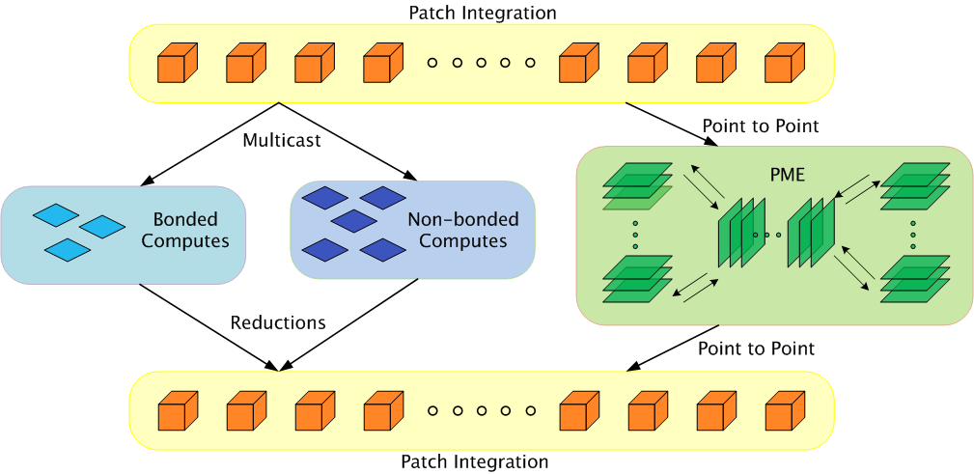
Parallelization using Charm++

Slide 9
Amdahl and variants
The original Amdahl’s law, interpreted as:
If there is a x% sequential component, speedup can’t be more than 100/x.
Variations:
If you decompose a problem into many parts, then the parallel time cannot be less than the largest of the parts
If the critical path through a computation is T1, you cannot complete in less time than T, no matter how many processors you use
…

Slide 10
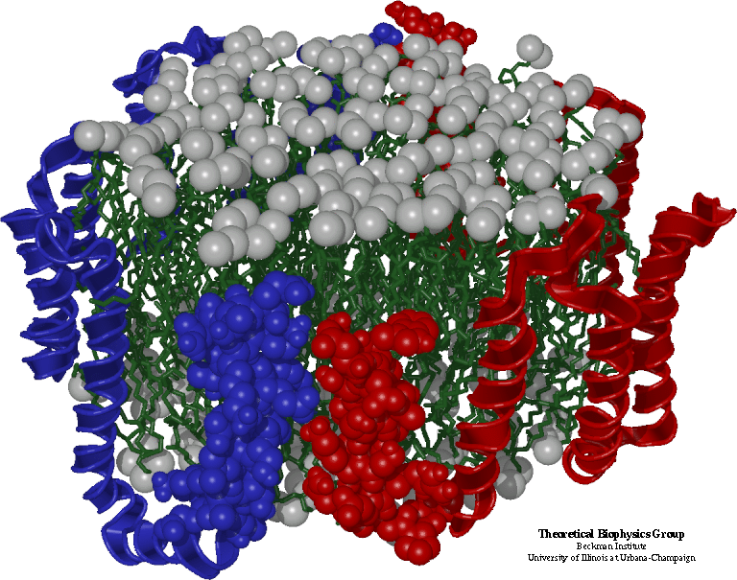
Grainsize and Amdahls’s law
A variant of Amdahl’s law, for objects:
The fastest time can be no shorter than the time for the biggest single object!
How did it apply to us?
Sequential step time was 57 seconds
To run on 2k processors, no object should be more than 28 msecs.
Analysis using our tools showed:

Slide 11
Grainsize analysis
Solution:
Split compute objects that may have too much work:
using a heuristics based on number of interacting atoms
Problem

Slide 12
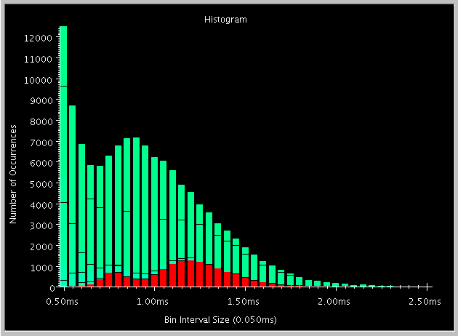
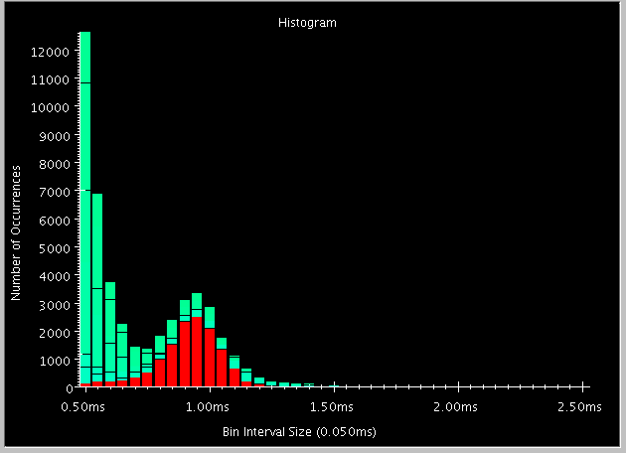
Fine Grained Decomposition on BlueGene

Slide 13
Grainsize reduced

Slide 14
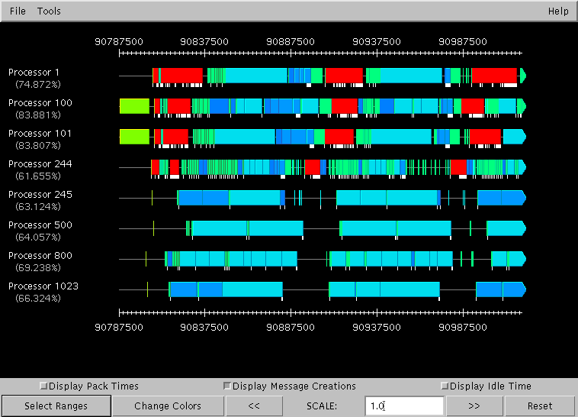
Integration overhead analysis
integration
Problem: integration time had doubled from sequential run

Slide 15
Integration overhead example:
The visualization showed: the overhead was associated with sending messages.
Many cells were sending 30-40 messages.
The overhead per message was too high
Code analysis: memory allocations!
Identical message being sent to 30+ processors.
Multicast support was added to Charm++
Mainly eliminates memory allocations

Slide 16
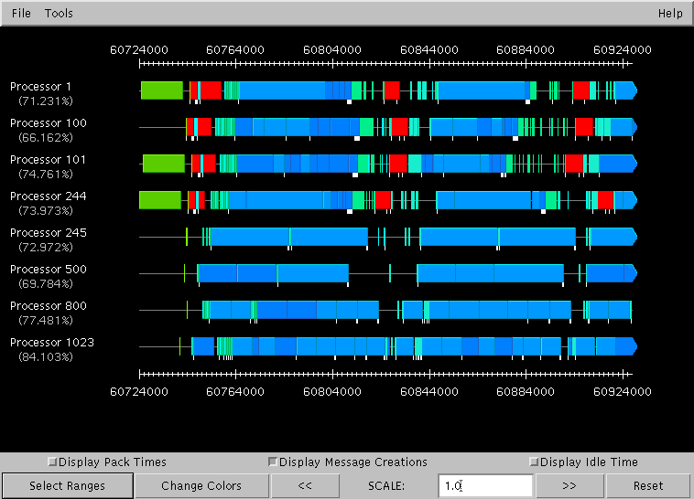
Integration overhead: After

Slide 17
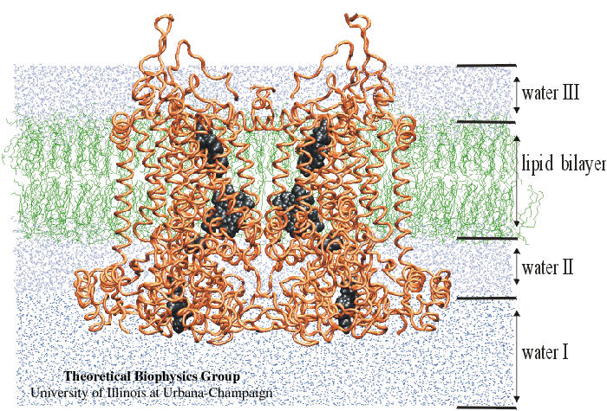
Improved Performance Data
Published in SC2000: Gordon Bell Award Finalist

Slide 18
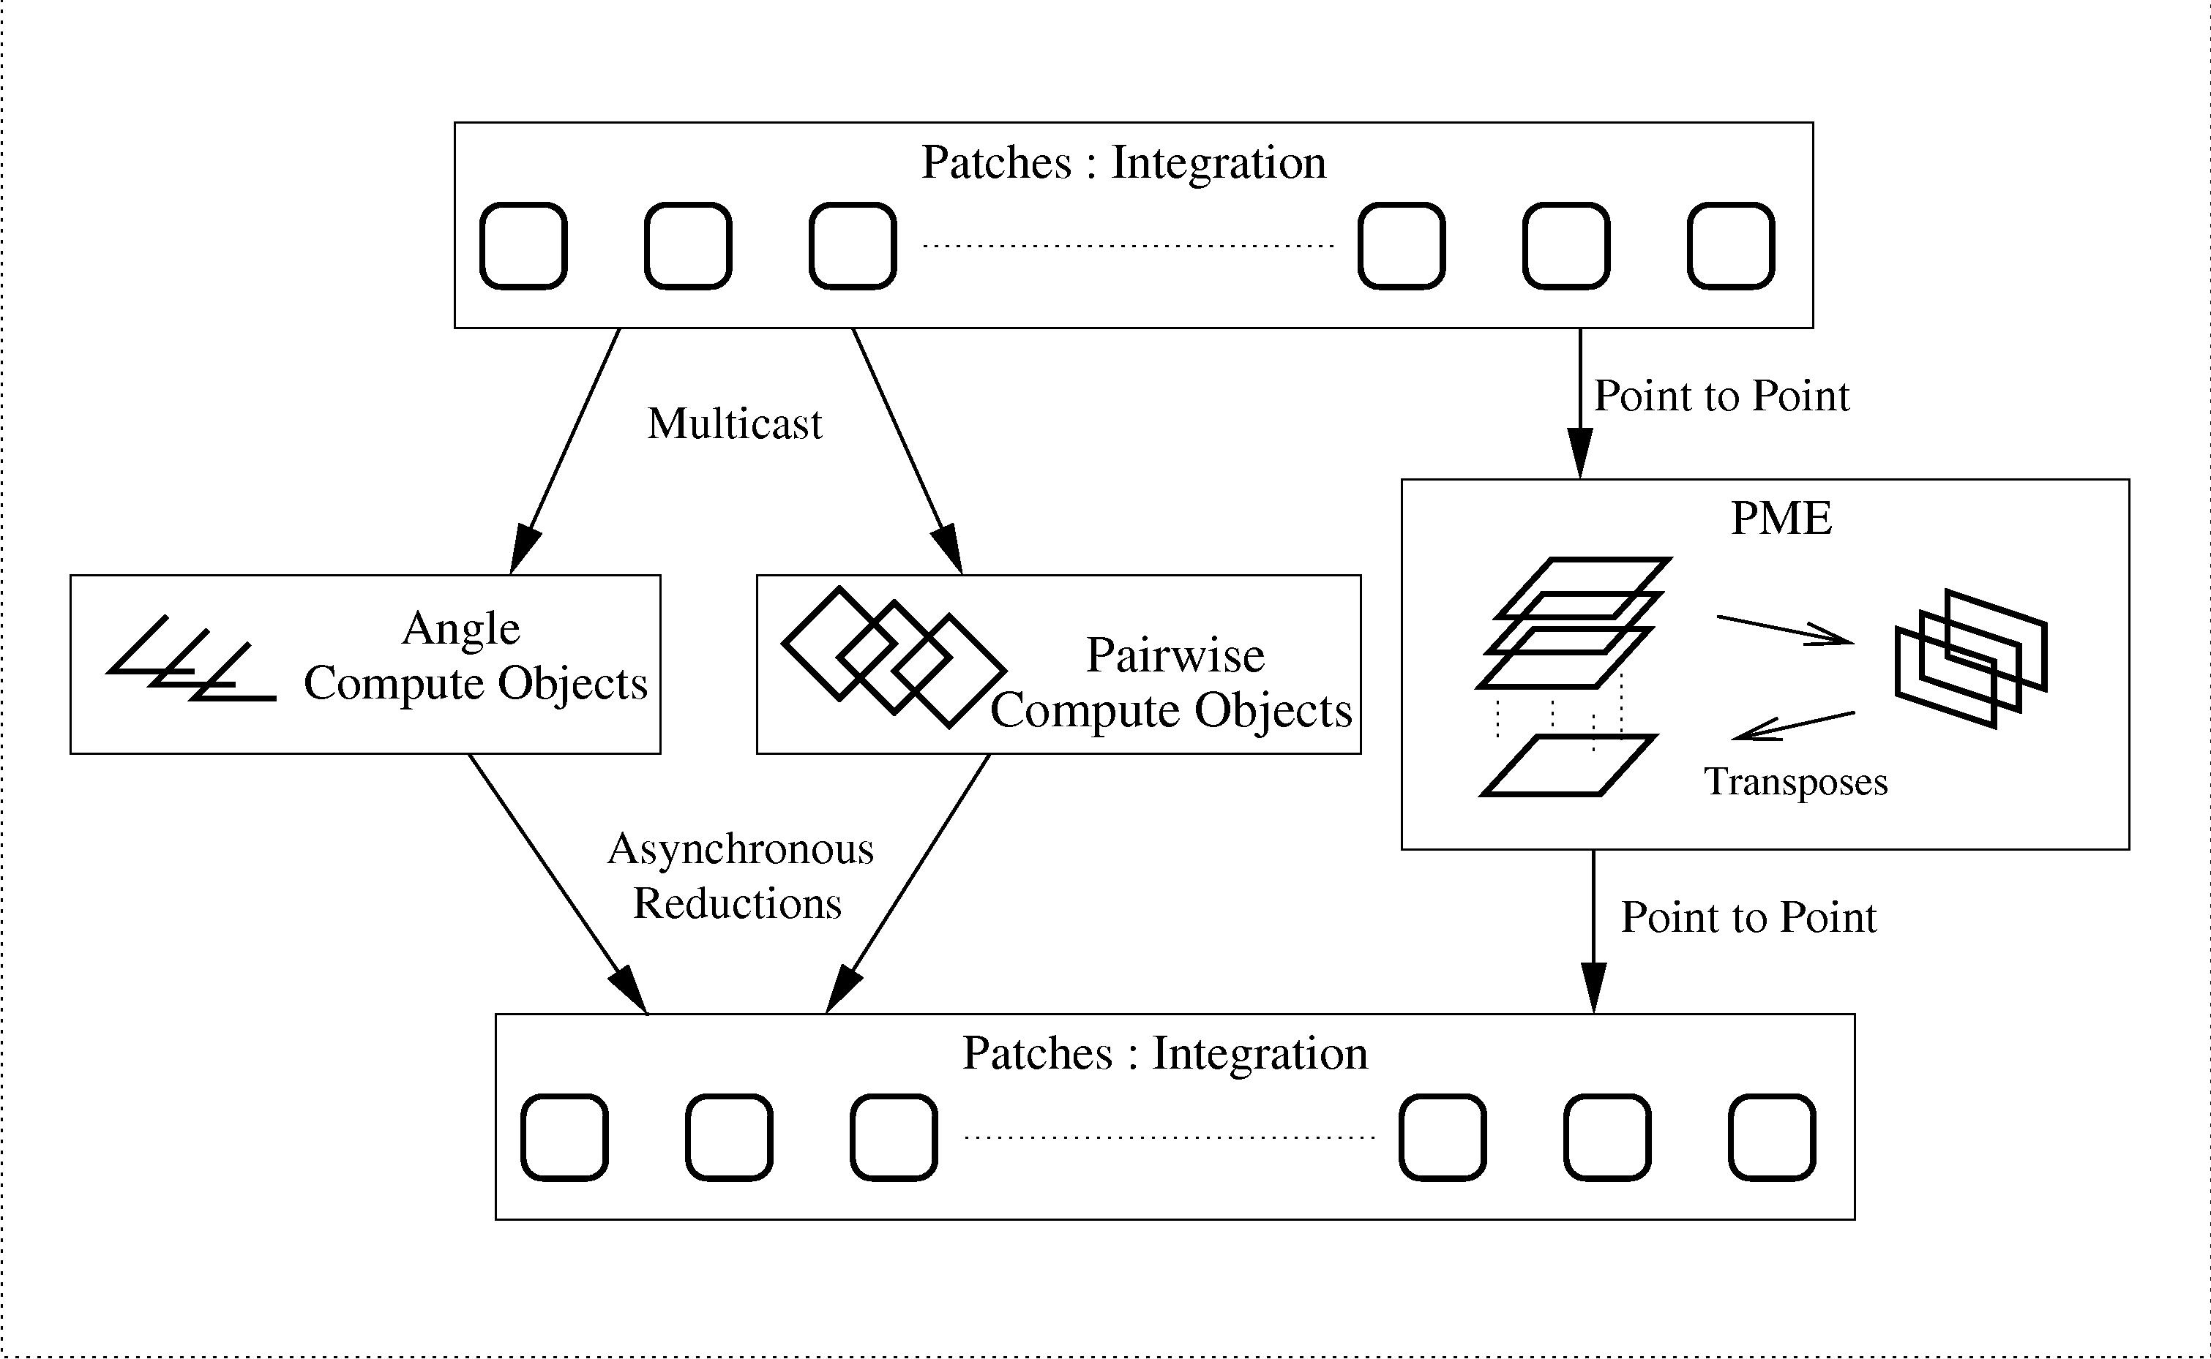
NAMD Parallelization using Charm++ : PME
192 + 144 VPs
700 VPs
30,000 VPs
These 30,000+ Virtual Processors (VPs) are mapped to real processors by charm runtime system

Slide 19
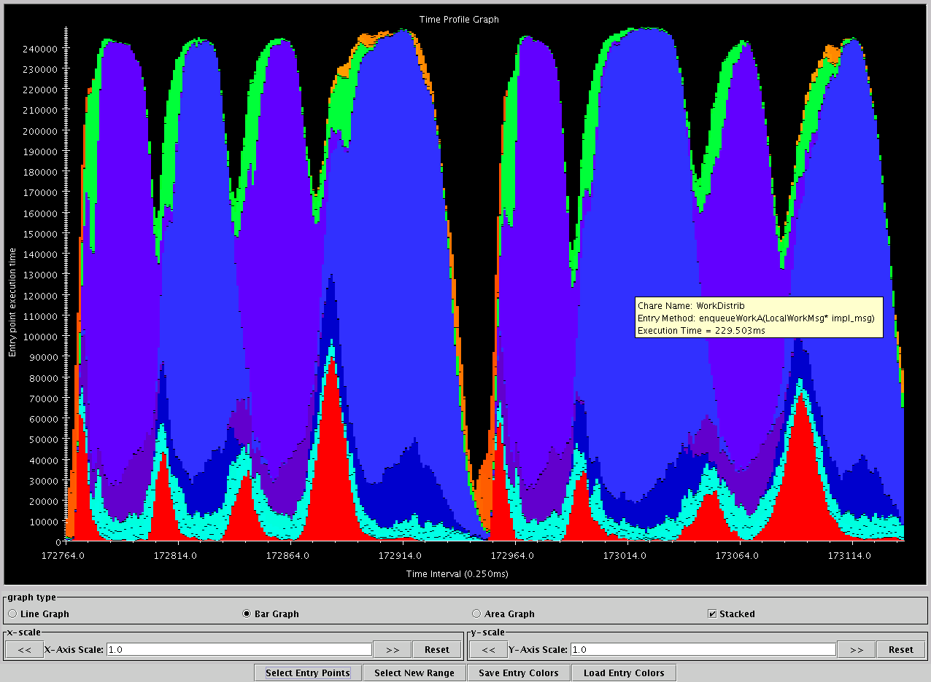
Whereas on BlueGene/L (recent tuning), 1024 procs
Shallow valleys, high peaks, nicely overlapped PME

Slide 20
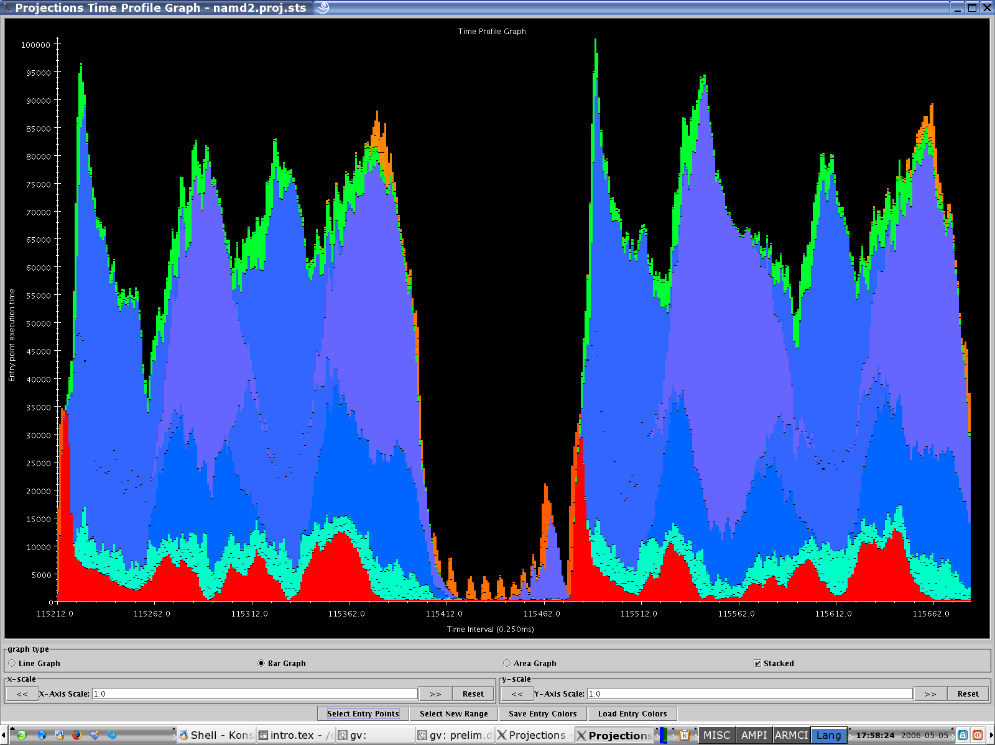
On Cray XT3, 512 processors

Slide 21
Grainsize example: NAMD
High performing examples (objects are the work-data units in Charm++):
On Blue Waters, 100M atom simulation
128K cores (4K nodes): 5,510,202 objects
Edison, Apoa1 (92K atoms)
4K cores: 33,124 objects
Hopper, STMV (1M atoms)
15,360 cores: 430,612 objects

Slide 22
NAMD strong scaling on Titan Cray XK7, Blue Waters Cray XE6, and Mira IBM Blue Gene/Q for 21M and 224M atom benchmarks

Slide 23
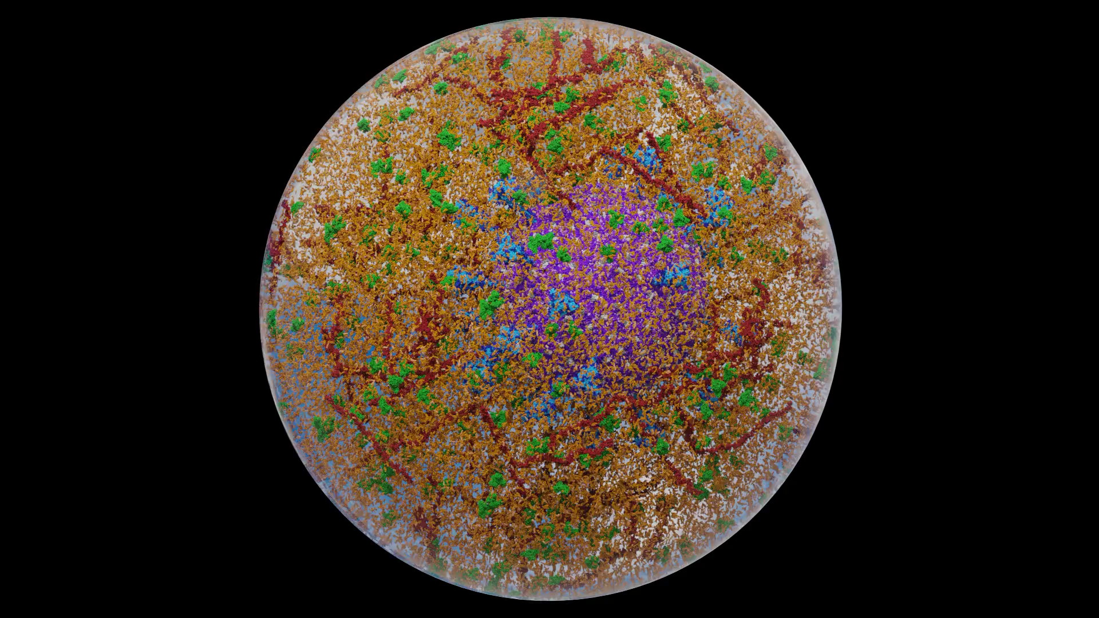
Recent success with NAMD:
Coronavirus
simulations
Credit: Amaro Lab UCSD

Slide 24
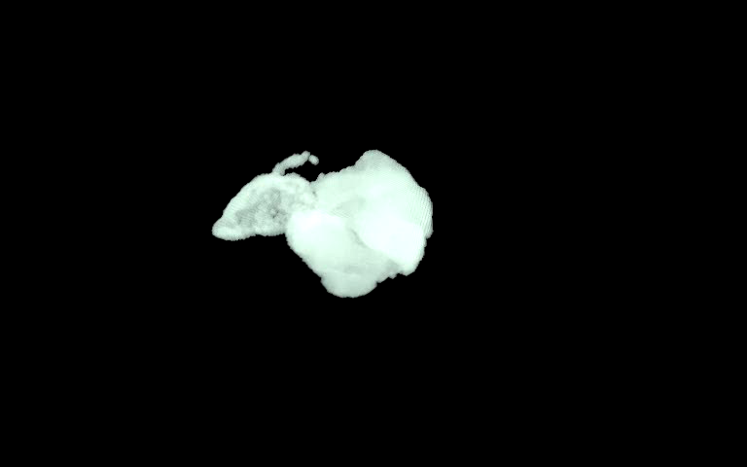
ChaNGa: Parallel Gravity
Evolution of Universe and Galaxy Formation
Collaborative project (NSF)
with Tom Quinn, Univ. of Washington
Gravity, gas dynamics
Barnes-Hut tree codes
Oct tree is natural decomp
Geometry has better aspect ratios, so you “open” up fewer nodes
But is not used because it leads to bad load balance
Assumption: one-to-one map between sub-trees and PEs
Binary trees are considered better load balanced
With Charm++: Use Oct-Tree, and let Charm++ map subtrees to processors

Slide 25
ChaNGa: Parallel Gravity
Evolution of Universe and Galaxy Formation
Collaborative project (NSF)
with Tom Quinn, Univ. of Washington
Gravity, gas dynamics
Barnes-Hut tree codes
Oct tree is natural decomp
Geometry has better aspect ratios, so you “open” up fewer nodes
But is not used because it leads to bad load balance
Assumption: one-to-one map between sub-trees and PEs
Binary trees are considered better load balanced
With Charm++: Use Oct-Tree, and let Charm++ map subtrees to processors

Slide 26
ChaNGa: Cosmology Simulation
Collaboration with Tom Quinn UW
Tree: Represents particle distribution
TreePiece: object/chares containing particles
Notes:
Animation1 - For clustered datasets, TreePieces containing those red nodes receive high volume of request

Slide 27
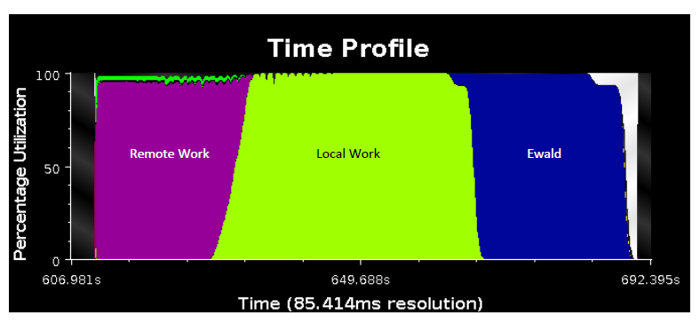
ChaNGa: Optimized Performance
Asynchronous, highly overlapped, phases
Requests for remote data overlapped with local computations

Slide 28
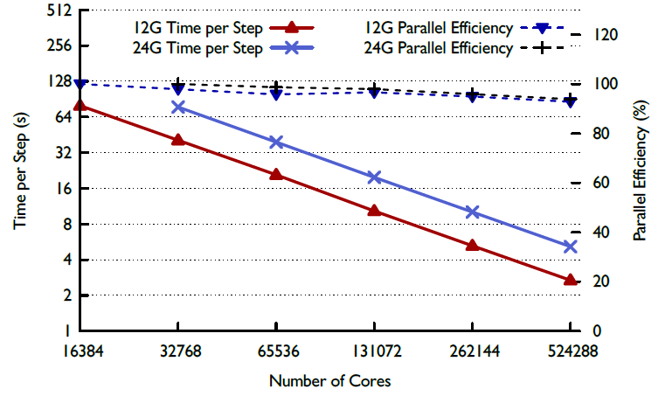
ChaNGa : Resultant Performance on Blue Waters

Slide 29
Clustered Dataset - Dwarf
Idle time due to message delays
Also, load imbalances: solved by Hierarchical balancers
Highly clustered
Maximum request per processor: > 30K
Notes:
Animation 1 : Shows volume
Animation 2 : Time profile

Slide 30
Solution: Replication
PE 1
PE 2
PE 3
PE 4
Replicate tree nodes to distribute requests
Requester randomly selects a replica

Slide 31
Replication Impact
Replication distributes requests
Maximum request reduced from 30K to 4.5K
Gravity time reduced from 2.4 s to 1.7 s, on 8k
Notes:
Gravity time reduced from 2.4 s to 1.7 s for 8k cores and from 2.1 s to 0.99 t 16K

Slide 32
Multiple time-stepping!
Our scientist collaborators suggest an algorithmic optimization:
Don’t move slow-moving particles every step
i.e. don’t calculate forces on them either
In fact, make many (say 5) categories (rungs) of particles based on their velocities
Rung sequence (with 5 rungs)
4 3 4 2 4 3 4 1 4 3 4 2 4 3 4 0
Rung 0: all particles, Rung 4: fastest-moving particles
Each tree-piece object now presents a different load when different “rungs” are being calculated

Slide 33
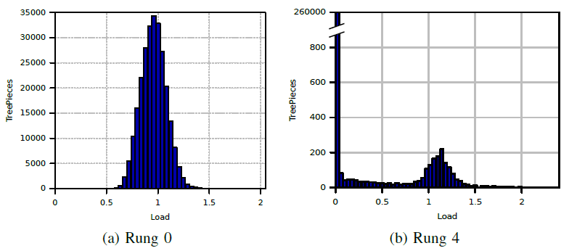
Multiple time-stepping!
Load (for the same object) changes across rungs
Yet, there is persistence within the same rung!
So, specialized phase-aware balancers were developed

Slide 34
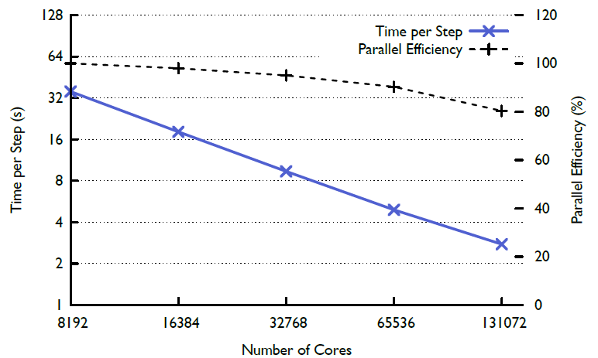
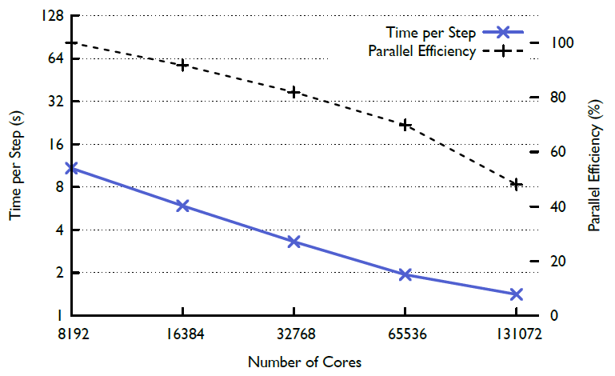
Multi-stepping tradeoff
Parallel efficiency is lower, but performance is improved significantly
Single Stepping
Multi Stepping

Slide 35
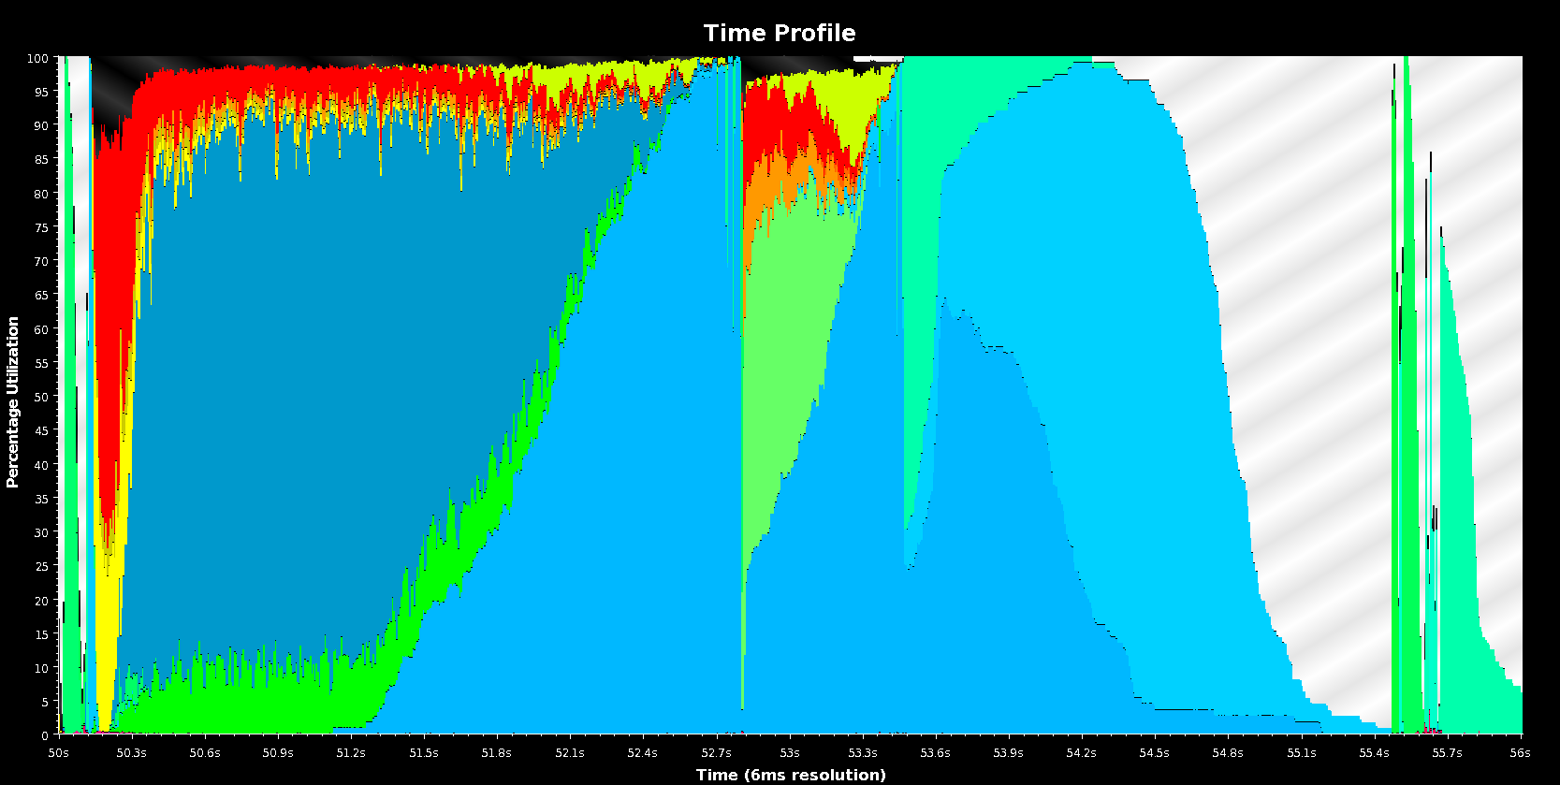
Overlapping of Phases
EOS
Ewald
Remote Gravity
SPH
Pressure
Local Gravity
SPH Density

Slide 36
ChaNGA Design and Optimization: Lessons
Many details in: https://charm.cs.illinois.edu/papers/14-30
Rethink relationship to processors
Oct-trees, overdecomposition
Don’t take performance and scaling losses for granted
Rage against them!
Detailed analysis , in part with projections, helps
Request-clustering was unexpected problem, needed a clever solution
Other optimizations not discussed here:
Task-based within node balancing
SMP cache (more in ParaTreeT)

Slide 37
Episimdemics
Simulation of spread of contagion
Code by Madhav Marathe, Keith Bisset, .. Vtech
Original was in MPI
Converted to Charm++
Benefits: asynchronous reductions improved performance considerably

Slide 40
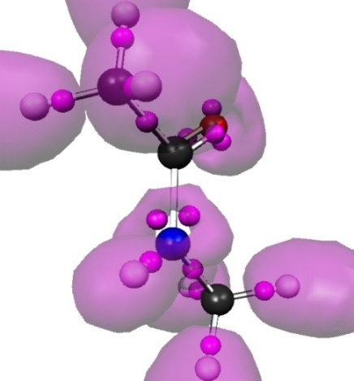
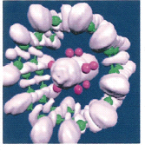
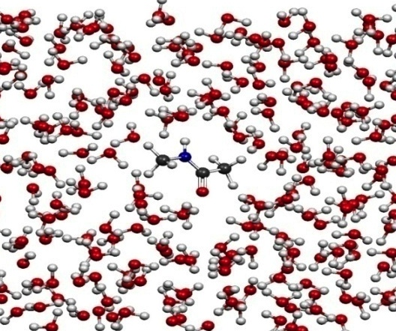
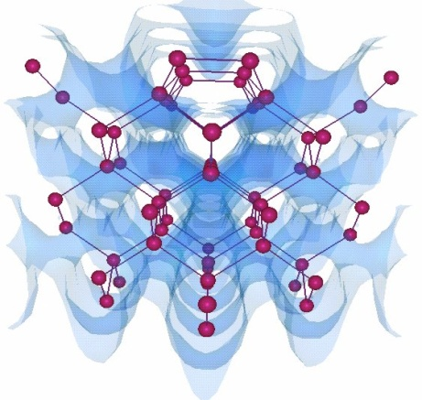
OpenAtom
Car-Parinello Molecular Dynamics
NSF ITR 2001-2007, IBM, DOE,NSF
Molecular Clusters :
Nanowires:
Recent NSF SSI-SI2 grant
With
G. Martyna (IBM)
Sohrab Ismail-Beigi
Semiconductor Surfaces:
3D-Solids/Liquids:
Using Charm++ virtualization, we can efficiently scale small (32 molecule) systems to thousands of processors

Slide 41
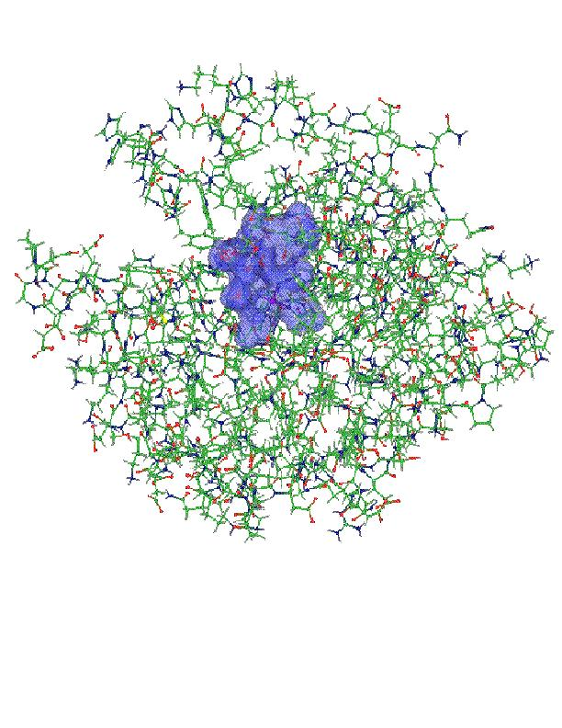
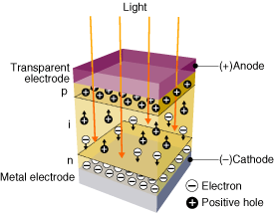
OpenAtom: On the fly ab initio molecular dynamics on the ground state surface with instantaneous GW-BSE level spectra
PIs: G.J. Martyna, IBM; S. Ismail-Beigi, Yale; L. Kale, UIUC;
Team: Q. Li, IBM, M. Kim, Yale; S. Mandal, Yale;
E. Bohm, UIUC; N. Jain, UIUC; M. Robson, UIUC; E. Mikida, UIUC; P. Jindal, UIUC; T. Wicky, UIUC.
Light in
1

Slide 42
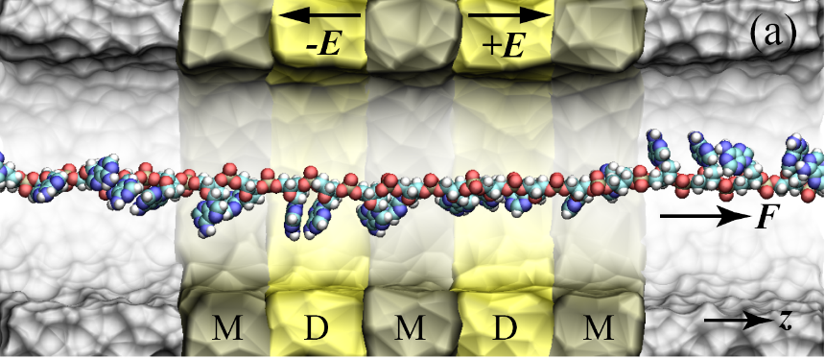

Goal : The accurate treatment of complex heterogeneous
systems to gain physical insight.
Light in
7

Slide 43
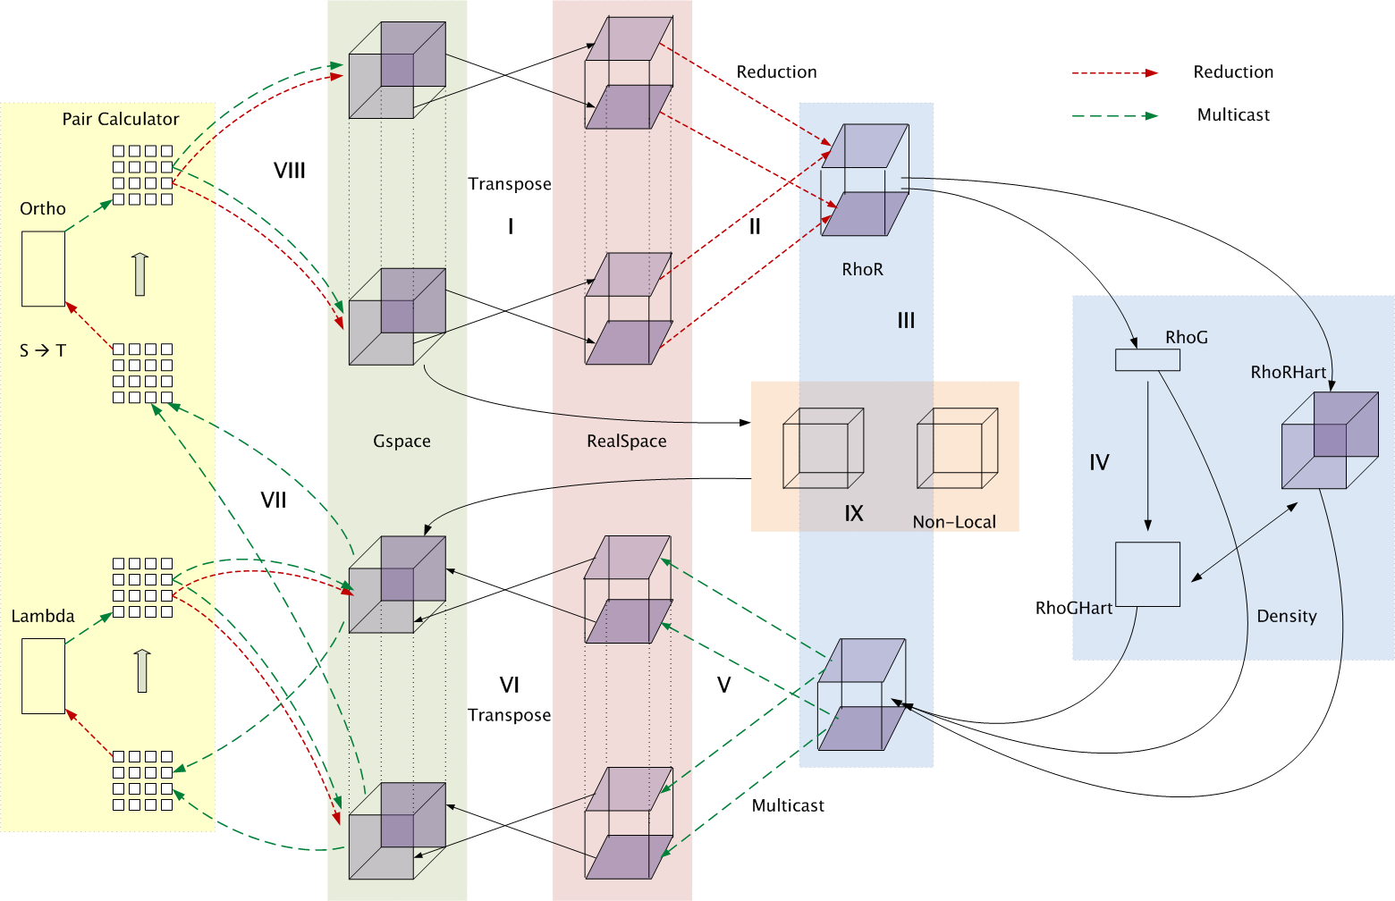
Decomposition and Computation Flow

Slide 44
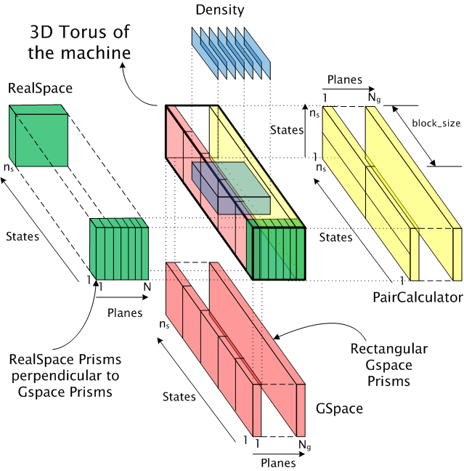
Topology Aware Mapping of Objects

Slide 45
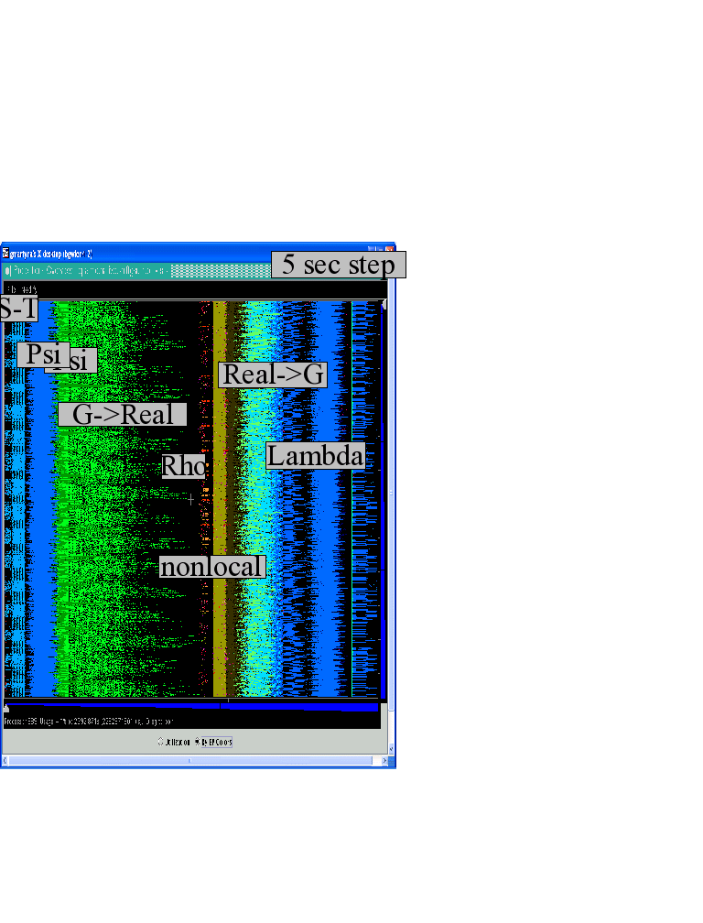
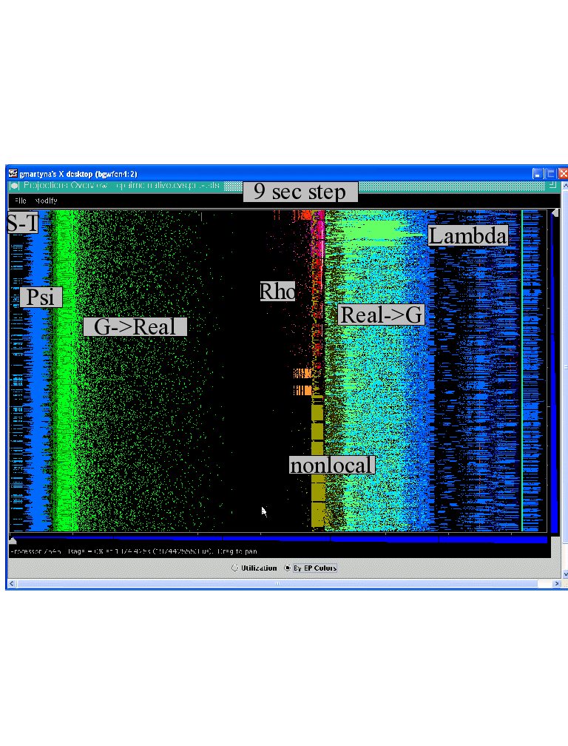
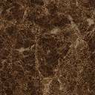
Improvements by topological aware mapping of computation to processors
Punchline: Overdecomposition into Migratable Objects created the degree of freedom needed for flexible mapping
The simulation of the left panel, maps computational work to processors taking the network connectivity into account while the right panel simulation does not. The “black’’ or idle time processors spent waiting for computational work to arrive on processors is significantly reduced at left. (256waters, 70R, on BG/L 4096 cores)

Slide 46
OpenAtom Performance Sampler
Ongoing work on:
K-points

Slide 47
Impact of mapping on Blue Waters: up to 32% improvement

Slide 48
MiniApps
Available at: http://charmplusplus.org/miniApps/
Mini-App | Features | Machine | Max cores
AMR | Overdecomposition, Custom array index, Message priorities, Load Balancing, Checkpoint restart | BG/Q | 131,072
LeanMD | Overdecomposition, Load Balancing, Checkpoint restart, Power awareness | BG/P BG/Q | 131,072 32,768
Barnes-Hut (n-body) | Overdecomposition, Message priorities, Load Balancing | Blue Waters | 16,384
LULESH 2.02 | AMPI, Over-decomposition, Load Balancing | Hopper | 8,000
PDES | Overdecomposition, Message priorities, TRAM | Stampede | 4,096

Slide 49
More MiniApps
Mini-App | Features | Machine | Max cores
1D FFT | Interoperable with MPI | BG/P BG/Q | 65,536 16,384
Random Access | TRAM | BG/P BG/Q | 131,072 16,384
Dense LU | SDAG | XT5 | 8,192
Sparse Triangular Solver | SDAG | BG/P | 512
GTC | SDAG | BG/Q | 1,024
SPH |  | Blue Waters | -

Slide 50
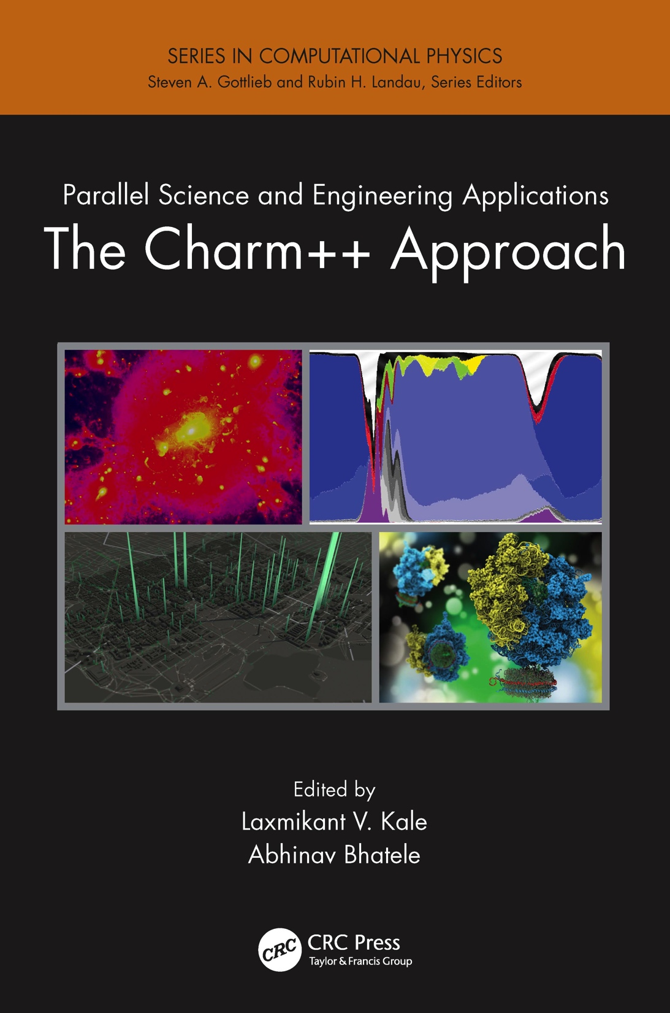
A recently published book
surveys seven major applications developed using Charm++
More info on Charm++:
http://charm.cs.illinois.edu
Including the miniApps

